Slide 1


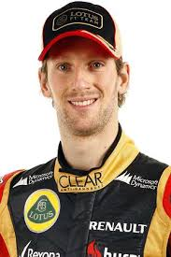

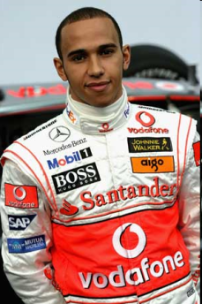






Le grand prix de la France
vs
Name | Romain Grosjean | Lewis Hamilton
age | 27 | 29
From | France | Angleterre
# | 8 | 44
Gagnant!
Gagnant!
[
[
1
2
3
4
5
6
7
8
9
10

Slide 2
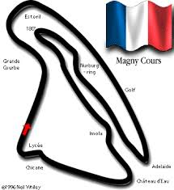

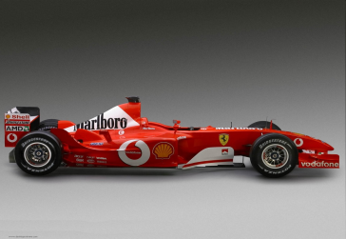

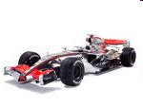
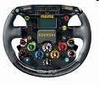
Le grand prix de la France
La couche d’ozone =
A
Hole in ozone layer
B
Bad for the ozone
C
The ozone layer
D
Good for the ozone

Slide 3
Le grand prix de la France
rechauffer
A
A driver
B
To heat up
C
To switch on
D
To recycle

Slide 4
Le grand prix de la France
L’effet de serre
A
Affecting the environment
B
A serious effect
C
droughts
D
The greenhouse effect

Slide 5
Le grand prix de la France
diminuer
A
To reduce
B
To switch off
C
To increase
D
To accelerate

Slide 6
Le grand prix de la France
Les déchets
A
rubbish
B
bins
C
Exhaust fumes
D
Organic products

Slide 7
Le grand prix de la France
L’essence
A
essential
B
environment
C
perfume
D
petrol

Slide 8
Le grand prix de la France
bruyant
A
quiet
B
annoying
C
noisy
D
wasteful

Slide 9
Le grand prix de la France
Un camion
A
car
B
lorry
C
Traffic jam
D
scooter

Slide 10
Le grand prix de la France
allumer
A
To switch on
B
To pollute
C
To switch off
D
To put on standby

Slide 11
Le grand prix de la France
sale
A
dirty
B
clean
C
sales
D
crowded

